Slide 1
Burrow Hill Park playing field survey
In March/April 2022 the Parish Council ran an online survey asking Burton Green residents what they would like to see at the new playing field at Burrow Hill Park.
We received 97 responses; the following slides give a summary of the results and additional comments.

Slide 2
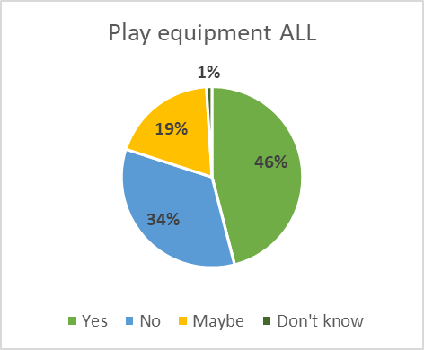
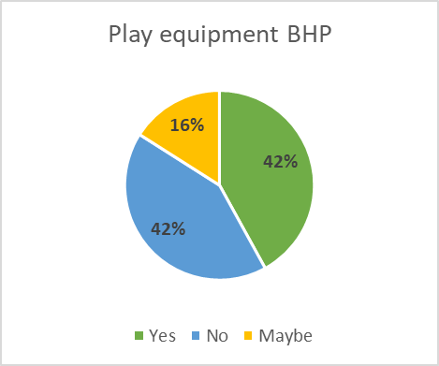
Area for children’s play equipment?
ALL: all entries BHP: entries from Burrow Hill Park residents
Additional comments:
All play equipment should be located at the corner of the field end of the car park, to minimise impact on housing.
The field is very small, not suited for play equipment.
Play equipment…could take up too much space and leave little space available for free play.
BG already has a play area so not sure why a small village needs two.
With the school being so close…it would be really nice to have something for the kids.
The space is not sufficiently large enough to accommodate a play area.

Slide 3
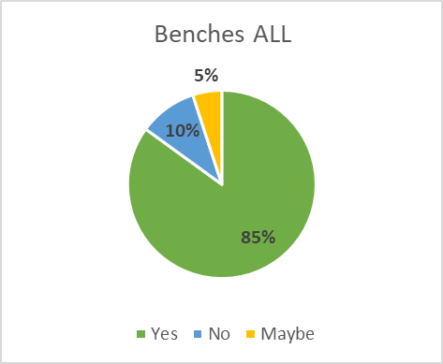
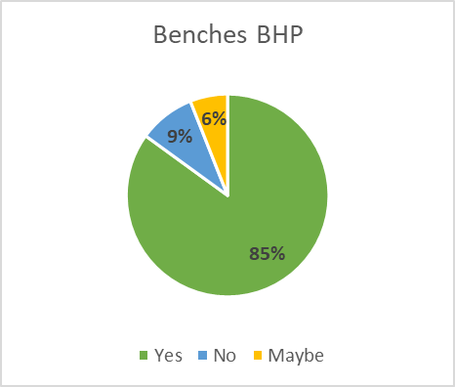
Benches?
Additional comments:
The odd bench would be fine.
The thing the field really needs is a bench or two.
Benches a must.
A couple of benches near the car park, away from our homes would be nice.
If anything is to be added to the field then a bench or two around the perimeter would be a welcome addition.

Slide 4
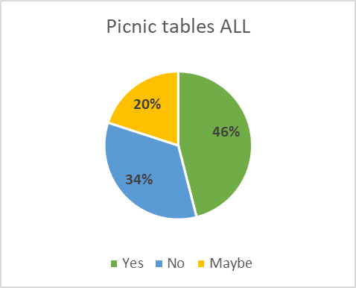
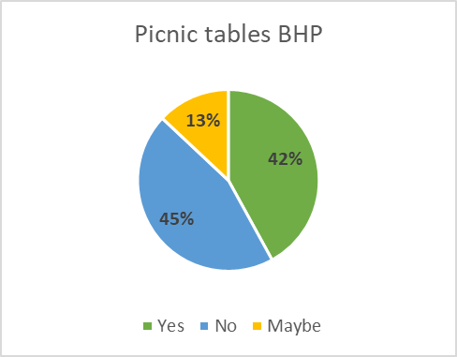
Picnic tables?
Additional comments:
Picnic benches encourage vermin so no go also encourages people from elsewhere to use it and this may mean people bring portable BBQs.
Benches may also invite people to have picnics etc and leave their rubbish behind which could result in vermin.

Slide 5
Outdoor gym, tennis table, goal posts?
Additional comments:
I have concerns about noise with gym/play equipment and groups gathering during unsociable hours.
Gym should be on the tunnel.
If goal posts were placed in, it would automatically create the booting of footballs in the direction of homes.

Slide 6
Space for free play?
Additional comments:
Burton Green does not have an open space for free play at all and we need one that is meaningful for ball games.
Field should be left as it is; residents are already making good use of it in its current state.
I’ve seen individuals playing football, cricket and rounders so there is already plenty of activities to partake in on the field.
Let’s keep it as a space that has maximum flexibility as to how it is used by individuals.
Space for community events.
Avoiding permanent structures would allow for a more versatile space for community gatherings.
It can be The Green – to replace the once which Burton Green had many moons ago.

Slide 7
Permit ball games?
Additional comments:
Since last summer…people have played balls games without hiccup or problems so I’m not sure there needs to be legislation about the use of the space.
Yes, with a curfew.
In designated area.
Wouldn’t want it churned up by footballers.
It’s been great to see families bring their own games equipment and use the field for family/group games.
I have a glass conservatory and am worried about balls flying and breaking my windows but with consideration and signs that may be fine.
Children playing rounders etc not a problem as long as they keep within the field.

Slide 8
Dogs
Additional comments:
Unfortunately, despite many diligent owners cleaning up mess there are a few who do not which therefore makes the space unsafe for children and families to use.
People with dogs not a problem as long as the breed type is safe on the field and off lead.
Dogs should be allowed as I’ve only ever seen residents use the field respectfully in this regard.
How would that ever be monitored and managed?
It is important that it doesn’t become a dog toilet or indeed that other users might be intimidated by free roaming animals – dogs on leads is a minimum.
I totally opposed dogs cause not all dog owners behave well re their dog’s behaviour and picking up.
I have seen people not pick up after their dogs; this would make it unsuitable for children to play football on.

Slide 9
Other comments:
Burton Green already has an equipped area of plan, which needs investment, and investment at Burrow Hill would ensure dilapidation of the existing park.
A height-restriction on the car park entry is an excellent idea.
Think of the residents that live opposite.
Signage on surrounding fence to highlight a play area for children and families.
Height restriction barrier at the car park is a good idea.
Must be kept in good order.
Please do not spoil this space.
Adding equipment, goal posts etc may invite people from outside the local community who have no responsibility for it’s maintenance and up keep.
Not a very large area, happy to leave as it and keep tidy. This field should be kept as it is.
Play equipment becomes noisy as it ages...and it will attract people to drive to park here to use it.
We need the flexibility of this space for community events.

Slide 10
Agreed actions
The Council reviewed the survey results in their meeting on 16th May 2022 and agreed the following actions:
Leave the field as space for free play and village events
Add one or two benches around the perimeter
Permit ball games
Install a general waste bin
The Council will decide whether or not dogs should be allowed on the field at the next Council meeting.
In the future: the Council will consider installing outdoor gym equipment and/or a children’s play area on top of the Green Tunnel.

